Slide 1

Title: Detection of AI-Generated Arabic Text
Course: MSIS-822 – Advanced Data Analytic Techniques
Supervised by: Prof.Mohammed Al-sarem
Presented by: Shoag Almodifer
Institution: Taibah University

Slide 2
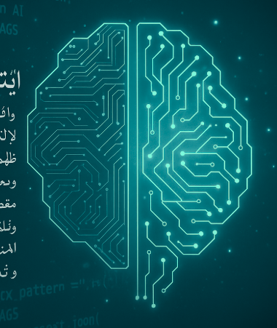
Problem Statement
In recent years,large Language Models (LLMs) like GPT-4, LLaMA and Jais can generate Arabic text that is almost identical to human writing.
Arabic AI-text detection is still underdeveloped compared to English, due to the lack of annotated Arabic datasets.
This raises some risks regarding academic integrity, fake research, and digital misinformation.

Slide 3
Preprocessing & Data Normalization
A multi-stage preprocessing pipeline was implemented to handle the linguistic complexity of Arabic text:
Text Normalization:
Unify letter forms (أ / إ / آ → ا )
Remove diacritics (tashkeel), digits, and special symbols.
Structural Cleaning:
Remove HTML tags, URLs, and email addresses.
Delete repeated punctuation and character elongations.
Normalize whitespace.

Slide 4
Preprocessing & Data Normalization Con’t
Tokenization & Stopword Removal:
Used NLTK Arabic tokenizer and extended the stopword lists.
Morphological Processing:
ISRI stemming to reduce words to root forms.
Stanza lemmatization to preserve grammatical meaning.
Quality Assurance:
Logs were used to track preprocessing errors.

Slide 5
Feature Engineering
Short Word Ratio (≤ 3 letters)
AI:
Jais: 10.8% (highest – frequent short connectors).
Allam: 9.7%, LLaMA: 8.9%, OpenAI: 8.1%.
Original: 9.8% (natural use of short function words).
Insight: Human and Jais texts include more short connectives and functional words
(e.g., “في”, “من”, “عن”).

Slide 6
Feature Engineering Con’t
2. Sentence Count
AI:
Allam: 4.49, Jais: 5.91, LLaMA: 5.66, OpenAI: 6.50 sentences on average.
Original: 7.43 sentences (longer and more complex).
Insight: Human texts are more segmented and syntactically rich while AI outputs are concise and dense.

Slide 7
Feature Engineering Con’t
3.Active Voice Sentences Count
Allam: 1.83, OpenAI: 1.32,Jais: 1.31, and LLaMA: 1.24.
Original: 1.46.
Insight: Allam model has been trained to generate a style that is overtly direct and assertive , while the other LLMs gravitate toward a more passive voice style.

Slide 8
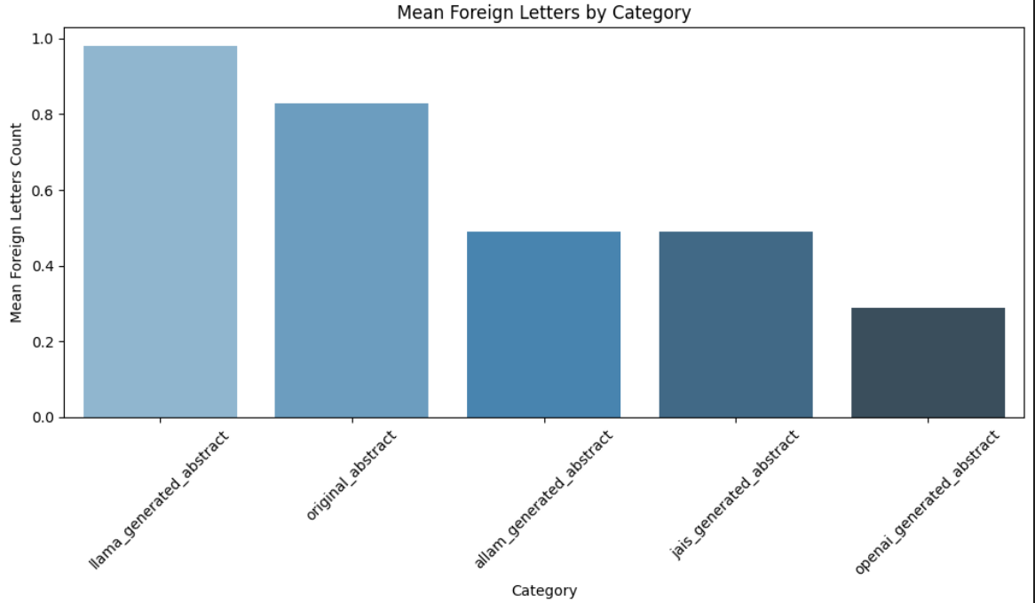
Feature Engineering Con’t
4. Foreign Letters Ratio
AI: LLaMA: 0.98, Allam & Jais: 0.49, OpenAI: 0.29.
Original: 0.83 (includes real English abbreviations or citations).
Insight: Human and LLaMA writing often mixes Arabic with foreign symbols while other AI-generated text remained nearly pure Arabic.

Slide 9
Feature Engineering Con’t
5. Redundancy Score
AI: Allam: 0.56, LLaMA: 0.55, Jais: 0.54, OpenAI: 0.52.
Original: 0.39 (much lower repetition).
Insight: AI-generated abstracts are more repetitive and template-like and human writing is diverse and context-driven.
6. Vocabulary Richness was measured by the Type-Token Ratio (TTR)
AI: 0.70–0.79 range.
Original: 0.798 (highest diversity).
Insight: Human abstracts use a broader and more varied vocabulary.

Slide 10
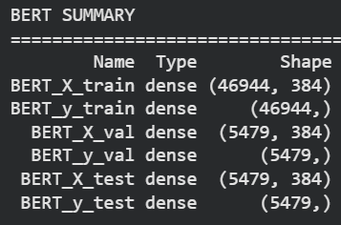
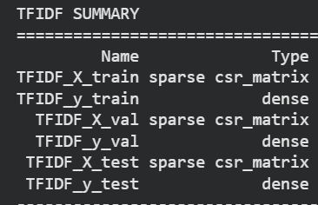
Embeddings & Data Splitting
Text is represented using lexical features extracted by Term Frequency–Inverse Document Frequency (TF-IDF) and semantic features using (BERT embeddings) before feeding into the model.
Data Splitting (70 / 15 / 15 : Train / Validation / Test)
Ensures fair model evaluation and prevents data leakage.
Training used for fitting, validation for tuning, and test for final performance check.

Slide 11
Feature Scaling & Data Balancing
StandardScaler:
Normalized numerical features (zero mean, unit variance) to improve model convergence and performance consistency.
SMOTE:
The dataset was balanced by creating synthetic samples for the minority class (human-written) to reduce model bias.

Slide 12
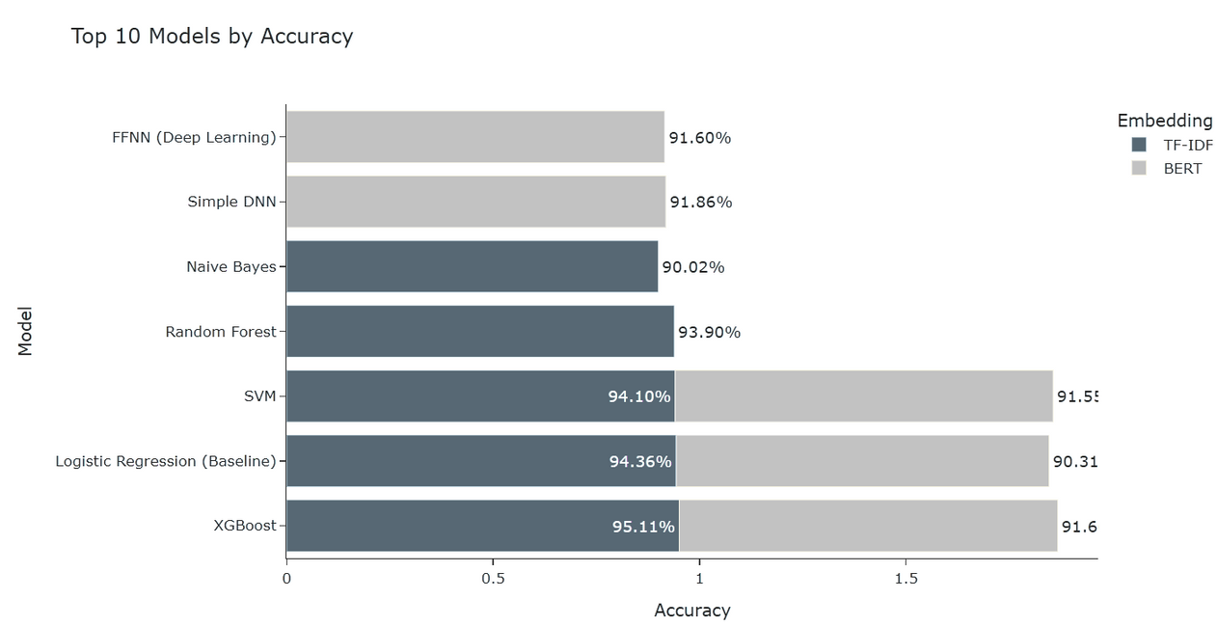
Results & Analysis
TF-IDF features were more effective for traditional ML models.
BERT embeddings worked better for deep models, improving contextual generalization.
XGBoost achieved the best overall performance accuracy 95.1% .
The Stylometric analysis validated these results:
∴ AI-generated texts were shorter, more redundant, and structurally repetitive compared to human texts.

Slide 13
Conclusion
Developed a complete Arabic AI-text detection pipeline (from data collection to model evaluation).
Built a custom Arabic preprocessing framework with normalization, diacritics removal, stemming, and lemmatization (Stanza + ISRI).
Extracted stylometric features such as sentence count, redundancy score, short-word ratio, number of active voices, and vocabulary richness to capture writing patterns.
Applied SMOTE to balance the dataset and StandardScaler to normalize numerical features, ensuring fair model training and consistent performance.
Compared TF-IDF (lexical) and BERT (contextual) embeddings across classical and deep learning models.
XGBoost with TF-IDF achieved the best overall performance (95.1% accuracy, 0.950 F1-score), confirming the strength of lexical features for Arabic text classification.

Slide 14
Thanks

